Slide 1

CS 584 Machine Learning
Week 14
April 17, 2019

Slide 2

Week 14 Agenda
Combining Multiple Learners
Bootstrap Method for Estimation
Introduction
Algorithm
Ensemble Model for Improving Goodness-of-Fit
Bagging
Adaptive Boosting (i.e., AdaBoost)
Gradient Boosting (i.e., GBM) – next lecture

Slide 3
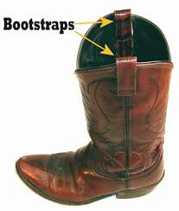
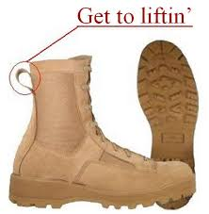
Bootstrap Method
Bootstrap, the Dictionary Meaning
(noun) A looped strap sewed at the side or the rear top of a boot to help in pulling it on
(Idiom) To pull oneself up by one's bootstraps – To succeed only on one’s own effort or abilities, despite limited resources, or to function independently without outside assistance

Slide 4
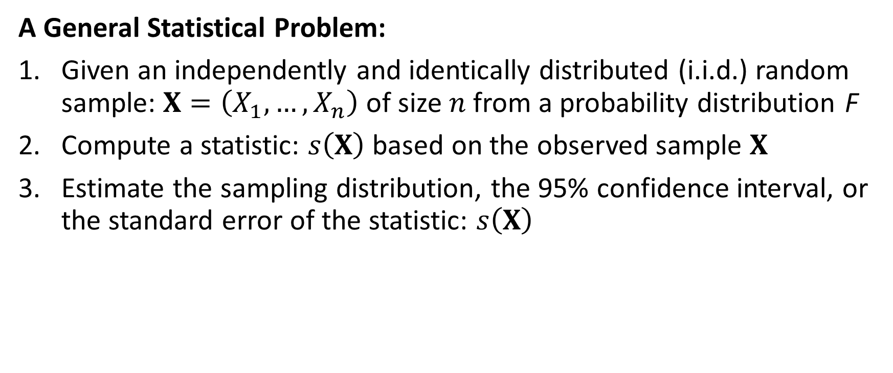
Bootstrap Method
A General Statistical Problem:
Given an independently and identically distributed (i.i.d.) random sample: $X=\left(X_{1},…,X_{n}\right)$ of size $n$from a probability distribution F
Compute a statistic: $s\left(X\right)$ based on the observed sample $X$
Estimate the sampling distribution, the 95% confidence interval, or the standard error of the statistic: $s\left(X\right)$

Slide 5
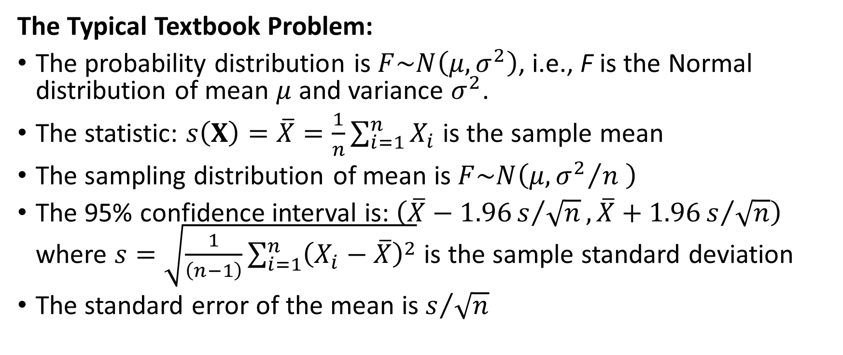
Bootstrap Method
The Typical Textbook Problem:
The probability distribution is $F\sim N\left(μ,σ^{2}\right)$, i.e., F is the Normal distribution of mean $μ$ and variance $σ^{2}$.
The statistic: $s\left(X\right)=\overline{X}=\frac{1}{n}\sum_{i=1}^{n}{X_{i}}$ is the sample mean
The sampling distribution of mean is $F\sim N\left(μ,{σ^{2}}/n \right)$
The 95% confidence interval is: $\left(\overline{X}−1.96s/{\sqrt{n}},\overline{X}+1.96s/{\sqrt{n}}\right)$ where $s=\sqrt{\frac{1}{\left(n−1\right)}\sum_{i=1}^{n}{{\left(X_{i}−\overline{X}\right)}^{2}}}$ is the sample standard deviation
The standard error of the mean is $s/{\sqrt{n}}$

Slide 6
Bootstrap Method
Deviation from this Typical Textbook Problem:
The Central Limit Theorem asserts that the sample mean will distribute asymptotically as a Normal distribution although the probability distribution F is not Normal.
Questions:
What if the sample size is not that big, say, n = 10?
What if the statistic is not the sample mean, say the median, the standard deviation, or the range?
What if the distribution F is multivariate and the statistic is the Pearson correlation coefficient?

Slide 7
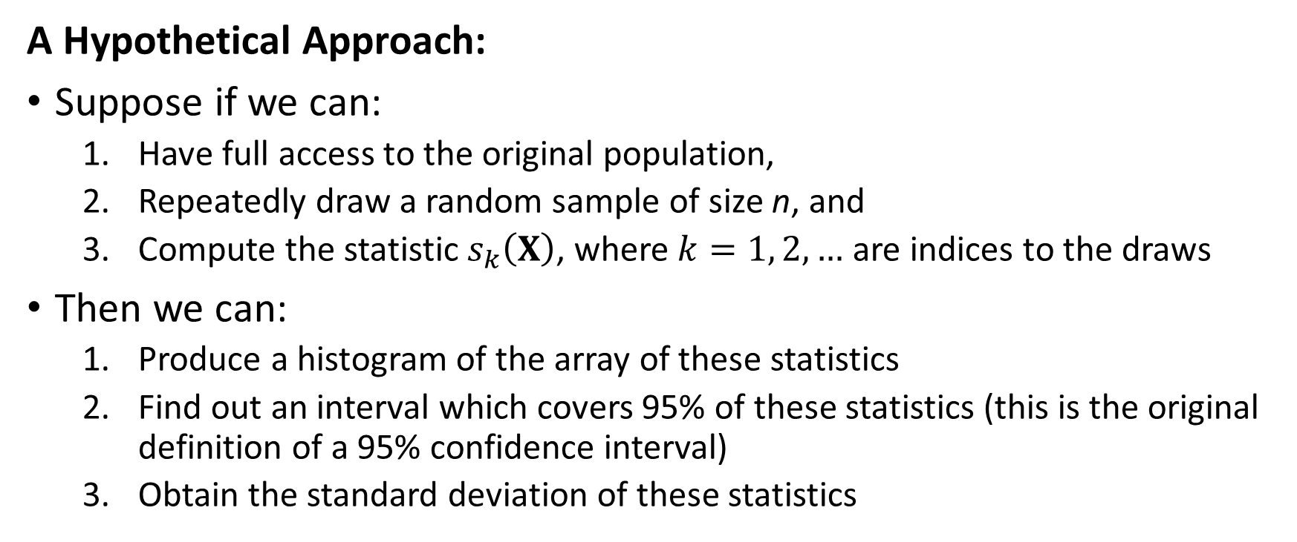
Bootstrap Method
A Hypothetical Approach:
Suppose if we can:
Have full access to the original population,
Repeatedly draw a random sample of size n, and
Compute the statistic $s_{k}\left(X\right)$, where $k=1, 2, …$ are indices to the draws
Then we can:
Produce a histogram of the array of these statistics
Find out an interval which covers 95% of these statistics (this is the original definition of a 95% confidence interval)
Obtain the standard deviation of these statistics

Slide 8
Bootstrap Method
The reality is that the original population may be not available for various reasons:
The original population cannot be directly observed
We may not locate all patients, who were not diagnosed with a deadly disease (e.g., Severe Sepsis) but have passed away due to the disease, to calculate the mortality rate of the disease
It is logistically infeasible to observe the original population
Even the U.S. Census cannot contact and observe all the residents in the US who have an earned income to calculate the U.S. Median Income

Slide 9
Bootstrap Method
The alternative solution is to look at the sample multiple times
Since the sample comes from the population, the sample carries the genes of the population.
If we can introduce variations into the sample, then we may create another sample that represents the population.
Variations are in the form of the relative frequencies of the individual values.
Signs and magnitudes of the individual values remain unchanged.
We will draw or re-sample observations from the sample with replacement, and thus simulate as many “samples” as we can handle from the population.

Slide 10
Bootstrap Method
A Brief History
The bootstrap method was first published by Bradley Efron in 1979
Professor of Statistics at Stanford, http://statweb.stanford.edu/~ckirby/brad/
Bootstrap Methods: Another Look At The Jackknife, The Annals of Statistics, 1979, Volume 7, Number 1, Pages 1-26
The Jackknife, the Bootstrap and Other Resampling Plans, 1982, Society for Industrial and Applied Mathematics (SIAM), U.S.
An Introduction to the Bootstrap, 1993, Chapman & Hall, co-authored with R.J. Tibshirani (also at Stanford)

Slide 11
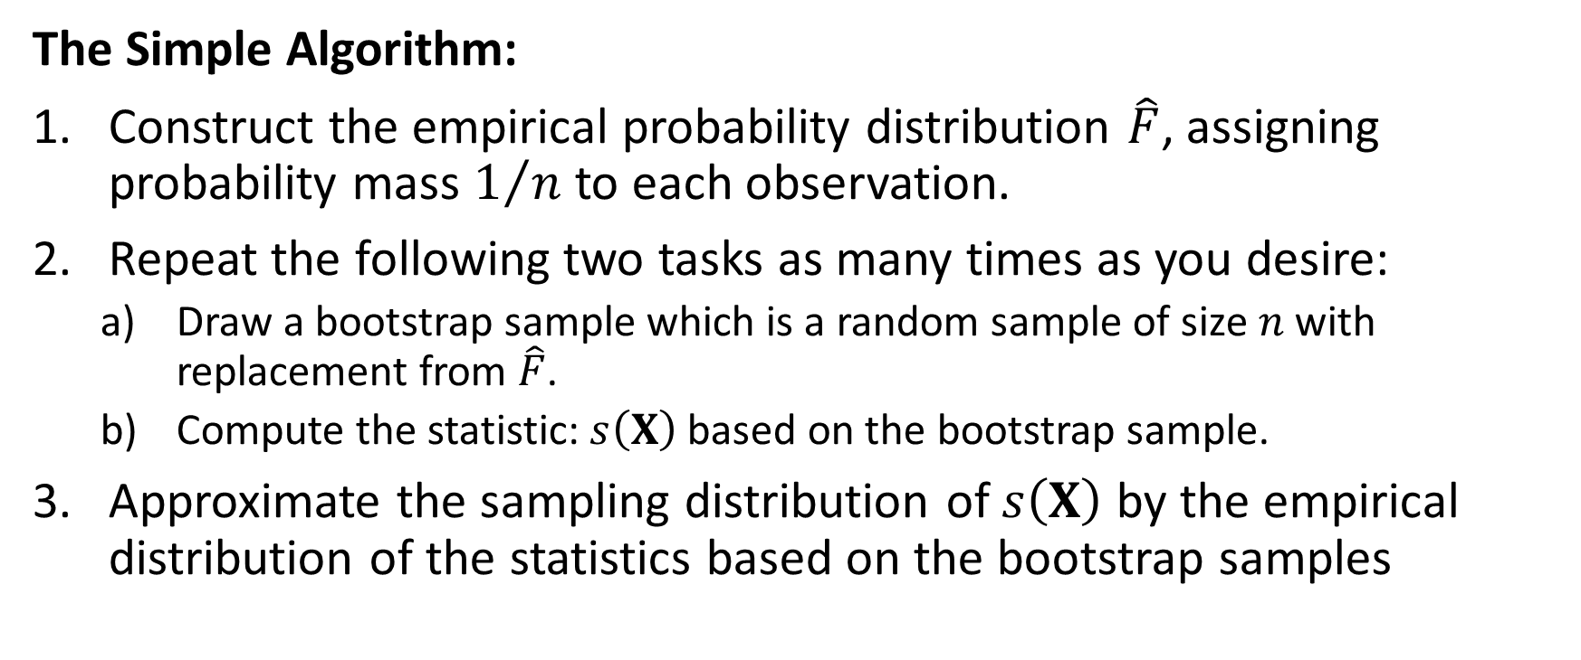
Bootstrap Method
The Simple Algorithm:
Construct the empirical probability distribution $\hat{F}$, assigning probability mass $1/n$ to each observation.
Repeat the following two tasks as many times as you desire:
Draw a bootstrap sample which is a random sample of size $n$with replacement from $\hat{F}$.
Compute the statistic: $s\left(X\right)$ based on the bootstrap sample.
Approximate the sampling distribution of $s\left(X\right)$ by the empirical distribution of the statistics based on the bootstrap samples

Slide 12
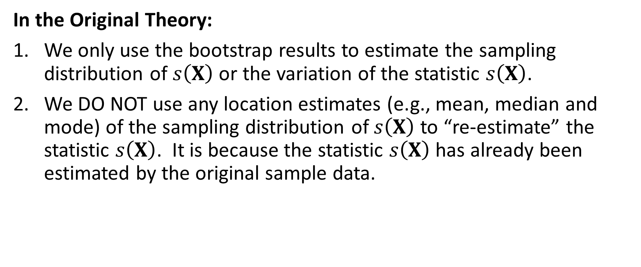
Bootstrap Method
In the Original Theory:
We only use the bootstrap results to estimate the sampling distribution of $s\left(X\right)$ or the variation of the statistic $s\left(X\right)$.
We DO NOT use any location estimates (e.g., mean, median and mode) of the sampling distribution of $s\left(X\right)$ to “re-estimate” the statistic $s\left(X\right)$. It is because the statistic $s\left(X\right)$ has already been estimated by the original sample data.

Slide 13

Bootstrap Method
Sampling With Replacement Using Python:
def sample_wr (inData):
n = len(inData)
outData = numpy.empty((n,1))
for i in range(n):
j = int(random.random() * n)
outData[i] = inData[j]
return outData
The bootstrap sample should have the same number of observations $n$ as the original sample.
Draw a random integer $j$ between 0 and $n−1$.
Pull the $j$^{th} observation from the original sample into the bootstrap sample.
1
2
3

Slide 14
Bootstrap Method
import numpy
import random
# Create a bootstrap sample from the population
def sample_wr (inData):
n = len(inData)
outData = numpy.empty((n,1))
for i in range(n):
j = int(random.random() * n)
outData[i] = inData[j]
return outData
x = numpy.array([1,2,3,4,5,6,7,8,10])
unique, counts = numpy.unique(x, return_counts = True)
print('Original Sample:\n', numpy.asarray((unique, counts)).transpose())
# Check the bootstrap sample
random.seed(20190417)
sample1 = sample_wr(x)
unique, counts = numpy.unique(sample1, return_counts = True)
print('Sample 1:\n', numpy.asarray((unique, counts)).transpose())
sample2 = sample_wr(x)
unique, counts = numpy.unique(sample2, return_counts = True)
print('Sample 2:\n', numpy.asarray((unique, counts)).transpose())
sample3 = sample_wr(x)
unique, counts = numpy.unique(sample3, return_counts = True)
print('Sample 3:\n', numpy.asarray((unique, counts)).transpose())
sample4 = sample_wr(x)
unique, counts = numpy.unique(sample4, return_counts = True)
print('Sample 4:\n', numpy.asarray((unique, counts)).transpose())
Week 14 Create Bootstrap Sample.py

Slide 15
Bootstrap Method
[data value, frequency count]
Original Sample:
[[ 1 1]
[ 2 1]
[ 3 1]
[ 4 1]
[ 5 1]
[ 6 1]
[ 7 1]
[ 8 1]
[10 1]]
Sample 1:
[[ 2. 2.]
[ 6. 1.]
[ 7. 3.]
[ 8. 1.]
[10. 2.]]
Sample 2:
[[2. 1.]
[3. 2.]
[4. 3.]
[8. 3.]]
Sample 3:
[[ 1. 2.]
[ 5. 1.]
[ 6. 3.]
[ 8. 2.]
[10. 1.]]
Sample 4:
[[1. 4.]
[3. 2.]
[7. 1.]
[8. 2.]]

Slide 16
Bootstrap Method
Bootstrapping Using Python:
In each bootstrap iteration:
Create a bootstrap sample
Calculate the statistic of interest accordingly
Append the statistic of interest to a dataset
Derive the summary on the statistic of interest
Generate the empirical distribution
Find a pair of values that enclose 95% of values
Calculate the standard deviation of values

Slide 17
Bootstrap Method: Mean Examples
Common Specifications
Input Data
Number of observations is 100
Data are simulated from a particular distribution
Random seed is 20190417
The summary statistic is the Mean
Bootstrapping
Get the standard error and 95% confidence interval of the summary statistic
500 and 1000 times
Week 14 Bootstrap Mean Example.py

Slide 18
Bootstrap Method: Mean Example 1
Input Data
Simulated Distribution: Normal, mean = 10, standard deviation = 7
Observed Mean ( z-Standard Error) is 10.3963263 ( 0.5944866)
95% z-Confidence Interval is (9.2311540, 11.5614987)
Bootstrapping 500 Times of the Mean Statistic
Mean is 10.4351727 and Standard Deviation is 0.6010027
95% Confidence Interval is (9.1998595, 11.6006601)
Bootstrapping 1000 Times of the Mean Statistic
Mean is 10.4133726 and Standard Deviation is 0.5786446
95% Confidence Interval is (9.2904089, 11.5279419)
The Confidence Intervals are Similar

Slide 19
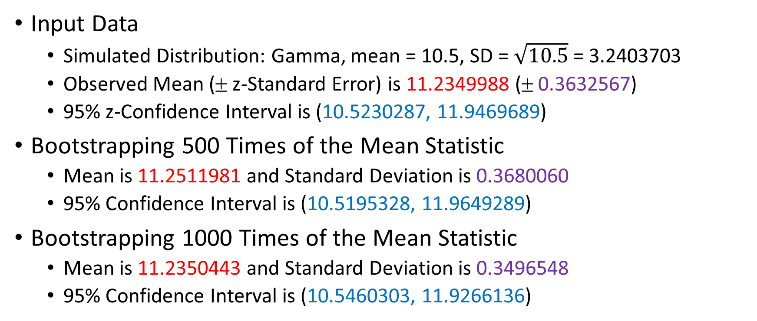
Bootstrap Method: Mean Example 2
Input Data
Simulated Distribution: Gamma, mean = 10.5, SD = $\sqrt{10.5}$ = 3.2403703
Observed Mean ( z-Standard Error) is 11.2349988 ( 0.3632567)
95% z-Confidence Interval is (10.5230287, 11.9469689)
Bootstrapping 500 Times of the Mean Statistic
Mean is 11.2511981 and Standard Deviation is 0.3680060
95% Confidence Interval is (10.5195328, 11.9649289)
Bootstrapping 1000 Times of the Mean Statistic
Mean is 11.2350443 and Standard Deviation is 0.3496548
95% Confidence Interval is (10.5460303, 11.9266136)
The Confidence Intervals are Similar

Slide 20
Bootstrap Method: Mean Example 3
Input Data
Simulated Distribution: Pr(X=1)=0.3, Pr(X=2)=0.1, Pr(X=3)=0.4, Pr(X=4)=0.2
E(X) = 2.5, Var(X) = 1.25, SD(X) = 1.1180340
Observed Mean ( z-Standard Error) is 2.3700000 ( 0.1205446)
95% z-Confidence Interval is (2.1337369, 2.6062631)
Bootstrapping 500 Times of the Mean Statistic
Mean is 2.3660000 and Standard Deviation is 0.1207626
95% Confidence Interval is (2.1400000, 2.6000000)
Bootstrapping 1000 Times of the Mean Statistic
Mean is 2.3660900 and Standard Deviation is 0.1163461
95% Confidence Interval is (2.1397500, 2.6000000)
The Confidence Intervals are Similar

Slide 21
Bootstrap Method: CV Examples
Common Specifications
Input Data
Number of observations is 100
Data are simulated from a particular distribution
Random seed is 20190417
The summary statistic is the Coefficient of Variation = SD / Mean (Note: this is a biased estimator of the population CV)
Bootstrapping
Get the standard error and 95% confidence interval of the summary statistic
500 and 1000 times
Week 14 Bootstrap CV Example.py

Slide 22
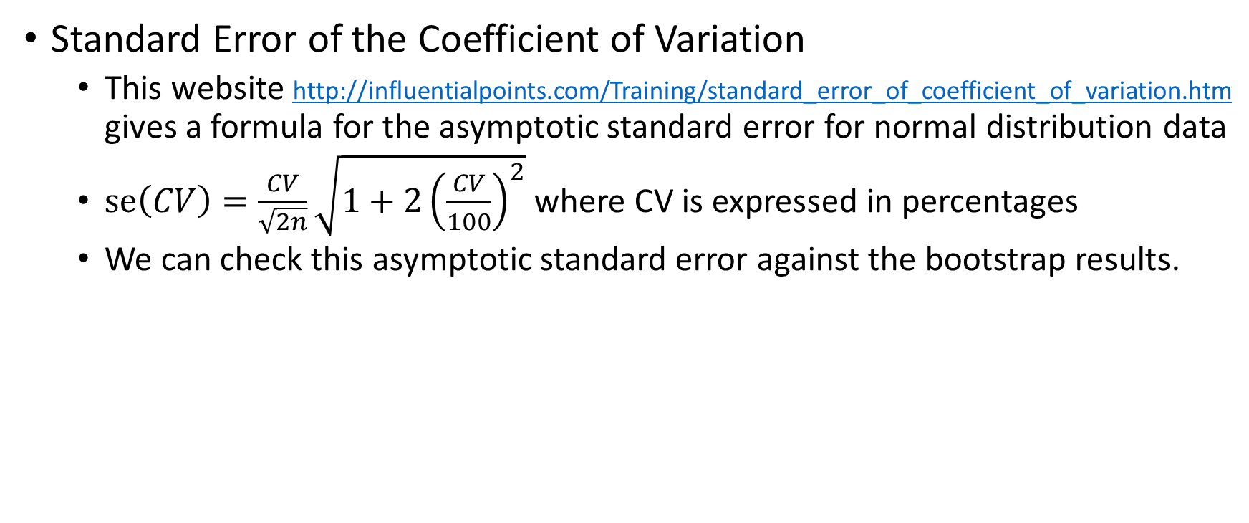
Bootstrap Method: CV Examples
Standard Error of the Coefficient of Variation
This website http://influentialpoints.com/Training/standard_error_of_coefficient_of_variation.htm gives a formula for the asymptotic standard error for normal distribution data
$se\left(CV\right)=\frac{CV}{\sqrt{2n}}\sqrt{1+2{\left(\frac{CV}{100}\right)}^{2}}$where CV is expressed in percentages
We can check this asymptotic standard error against the bootstrap results.
Week 14 Bootstrap CV Example.py

Slide 23
Bootstrap Method: CV Example 1
Input Data
Simulated Distribution: Normal, mean = 10, standard deviation = 7, CV = 70%
Observed CV ( z-Standard Error) is 57.1823729% ( 5.2000833%)
95% z-Confidence Interval is (46.9903969%, 67.3743489%)
Bootstrapping 500 Times of the CV Statistic
Mean is 56.9358445% and Standard Deviation is 5.7869214%
95% Confidence Interval is (46.6012757%, 68.8002313%)
Bootstrapping 1000 Times of the CV Statistic
Mean is 57.0239971% and Standard Deviation is 5.7025104%
95% Confidence Interval is (46.6397576%, 68.4436737%)

Slide 24
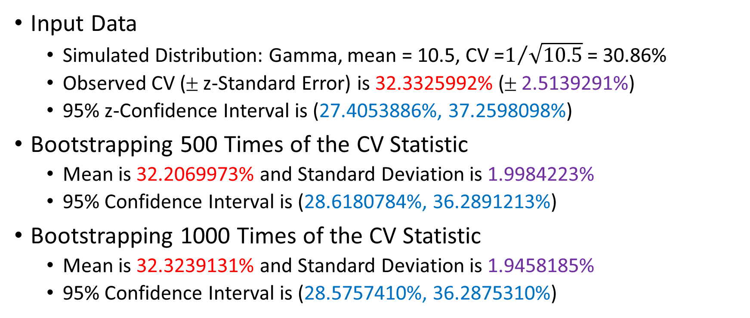
Bootstrap Method: CV Example 2
Input Data
Simulated Distribution: Gamma, mean = 10.5, CV =$1/{\sqrt{10.5}}$ = 30.86%
Observed CV ( z-Standard Error) is 32.3325992% ( 2.5139291%)
95% z-Confidence Interval is (27.4053886%, 37.2598098%)
Bootstrapping 500 Times of the CV Statistic
Mean is 32.2069973% and Standard Deviation is 1.9984223%
95% Confidence Interval is (28.6180784%, 36.2891213%)
Bootstrapping 1000 Times of the CV Statistic
Mean is 32.3239131% and Standard Deviation is 1.9458185%
95% Confidence Interval is (28.5757410%, 36.2875310%)

Slide 25
Bootstrap Method: CV Example 3
Input Data
Simulated Distribution: Pr(X=1)=0.3, Pr(X=2)=0.1, Pr(X=3)=0.4, Pr(X=4)=0.2
E(X) = 2.5, Var(X) = 1.25, theoretical CV is 25.82%
Observed CV ( z-Standard Error) is 50.8626994% ( 4.4303175%)
95% z-Confidence Interval is (42.1794366%, 59.5459622%)
Bootstrapping 500 Times of the CV Statistic
Mean is 51.0474285% and Standard Deviation is 3.0114898%
95% Confidence Interval is (44.9350052%, 56.6917786%)
Bootstrapping 1000 Times of the CV Statistic
Mean is 51.1596938% and Standard Deviation is 3.0467660%
95% Confidence Interval is (45.1091378%, 57.2086309%)

Slide 26
Bootstrap Method
Closing Remarks:
The Confidence Interval is simple to use, but actual probability coverage may be less than the nominal value, e.g., 95%.
The bootstrap method depends on the sample being representative. Otherwise, the re-sampling results will be inappropriate.
If the sample statistic of interest (e.g., the Coefficient of Variation) is already a biased estimate of the population statistic, then the bootstrap method will not correct the problem

Slide 27
Ensemble Methods
The Ensemble Method is a Machine Learning concept in which the idea is to train multiple models using the same learning algorithm.
The objective is to combine a set of models and create a stronger model that delivers better performance.
There are many ways to ensemble models. Among the most widely used techniques are Bagging and Boosting.
Bagging allows multiple similar models with high variance are averaged to decrease variance.
Boosting builds multiple incremental models to decrease the bias, while keeping variance small.

Slide 28
Bagging or Boosting
Overview Procedure:
Fix on a model of interest, i.e., select a supervised learner algorithm with desired specifications
Train the model of interest multiple times
Bagging: In parallel on different training samples
Boosting: Sequentially with different weights on observations
Assemble the predictions from the models, with or without weights
The ensemble prediction is the outcome of the Ensemble Method

Slide 29
Bagging
Bagging is Bootstrap Aggregating:
Create a bootstrap sample from the training partition
The model is trained individually on each bootstrap sample
Observations in a bootstrap sample are not weighted
Models’ predicted target values are summarized (without weights) to produce the ensemble prediction
Mean of the predicted values for an interval target
Mean of the predicted probabilities for a category of a categorical target
Mode of the predicted outcome of a categorical target (majority vote)

Slide 30
Bagging Example: HMEQ
Interval predictors: DELINQ and DEBTINC
Binary target: BAD (1 = Event, 0 = Non-Event)
5960 observations read
4,217 observations used after removing missing values in the predictors and the target variable
Assign the observations into the Training and the Testing partitions, stratified by the target variable
70% for Training, actually has 2,951 observations
30% for Testing, actually has 1,266 observations
Week 14 Bagging ClassTree Example.py

Slide 31
Bagging Example: HMEQ
Classification of Observations
Classify an observation as an Event if the predicted probability is greater than or equal to a threshold value
The threshold is the fraction of BAD = 1 observations in the Training partition
The threshold value is 0.09115554049474754
Classification Tree Specifications
Criterion is Entropy
Maximum depth is two (i.e., the tree has three layers including the root node)
Random seed is 60616

Slide 32
Bagging Example: HMEQ
Classification Tree Without Bagging:
Metrics are calculated on the Testing partition
Area Under Curve = 0.6562460
Misclassification Rate = 0.1074250
Root Average Squared Error = 0.2584909
Comments
The classification tree result is fairly good
Can we improve further?

Slide 33
Bagging Example: HMEQ
Classification Tree With Bagging:
def bootstrap_classTree (x_train, y_train, x_test, nB):
x_index = x_train.index
nT = len(y_test)
outProb = numpy.zeros((nT,2))
classTree = tree.DecisionTreeClassifier(criterion='entropy', max_depth=2, random_state=60616)
random.seed(20181114)
for iB in range(nB):
bootIndex = sample_wr(x_index)
x_train_boot = x_train.loc[bootIndex[:,0]]
y_train_boot = y_train.loc[bootIndex[:,0]]
treeFit = classTree.fit(x_train_boot, y_train_boot['BAD'])
outProb = outProb + classTree.predict_proba(x_test)
outProb = outProb / nB
return outProb

Slide 34
Bagging Example: HMEQ
Number of Bootstraps | Area Under Curve | Misclassification Rate | Root Average Squared Error
0 (No Bagging) | 0.6562460 | 0.1074250 | 0.2584909
10 | 0.7003135 | 0.1082148 | 0.2553437
50 | 0.7007442 | 0.1082148 | 0.2553244
100 | 0.7004911 | 0.1082148 | 0.2553433
500 | 0.7065199 | 0.1082148 | 0.2554015
1000 | 0.7065841 | 0.1097946 | 0.2553846
Comments
The more number of bootstraps, the higher the AUC metric and the lower the RASE
However, why do the Misclassification Rates go up on the contrary?

Slide 35
Bagging Example: HMEQ
Number of Bootstraps | Misclassification Rate | Mean Threshold | S.D. Threshold
0 (No Bagging) | 0.1074250 | 0.0911555 | 0
10 | 0.1082148 | 0.0905117 | 0.0065891
50 | 0.1082148 | 0.0915215 | 0.0060572
100 | 0.1082148 | 0.0915588 | 0.0059124
500 | 0.1082148 | 0.0913975 | 0.0056231
1000 | 0.1097946 | 0.0915161 | 0.0056149
Comments
Since the threshold actually vary within the bootstrap samples, using a threshold that depends on the original training partition is actually a bad idea. This is another moving target situation.

Slide 36
Bagging Example: HMEQ
Number of Bootstraps | Area Under Curve | Misclassification Rate | Root Average Squared Error
0 (No Bagging) | 0.6562460 | 0.0742496 | 0.2584909
10 | 0.7003135 | 0.0734597 | 0.2553437
50 | 0.7007442 | 0.0726698 | 0.2553244
100 | 0.7004911 | 0.0734597 | 0.2553433
500 | 0.7065199 | 0.0734597 | 0.2554015
1000 | 0.7065841 | 0.0734597 | 0.2553846
What if we use the uninformative threshold of 0.5?
New finding! The Misclassification Rates go down with bagging. However, the Misclassification Rates do seem to stay flat after 100 bootstrap samples.

Slide 37
Bagging: Number of Bootstrap Samples
Question:
Will more bootstrap samples give me a better model?
Answer:
Not Necessary, it depends on the metrics that you used
But you can increase your chance of getting a better model

Slide 38
Bagging: Should I Do It?
Implementation of Bagging is straightforward
Bagging can be applied to any supervised predictive models
Bagging will, in general, improve model goodness-of-fit, but for a price of model interpretation
Because the bagging actually build the same model on multiple training data
Then aggregate the multiple outcomes (e.g., predicted probabilities).
Bagging will consume more machine computing cycles and resources
Specify your number of bootstrap samples based on how long you can wait for the results.

Slide 39
Bagging in Python
You can, of course, implement your own Bagging function
Python offers efficient ways to perform Bagging
sklearn.ensemble.BaggingClassifier
sklearn.ensemble.BaggingRegressor

Slide 40
Application of Bagging – Random Forest
Build a decision tree on bootstrap samples
Make available a random subset of predictors for building the decision tree (in other words, give all the predictors their chances to enter into the tree model)

Slide 41
Adaptive Boosting (AdaBoost)
Boosting adaptively weighs observations:
The model is trained on the training partition (without weights)
Poorly predicted observations are assigned larger weights, such that subsequent model will try to improve their prediction accuracies
Iterate Step 2 until the overall model performance is desirable
Outcomes from the models (e.g., predicted probabilities) are aggregated with weights to produce the ensemble prediction
A model with poor model performance is given less weight
A model with good model performance is given more weight

Slide 42
Boosting: Toy Example
Index | x1 | x2 | y
0 | 0.1 | 0.3 | 1
1 | 0.2 | 0.2 | 1
2 | 0.3 | 0.1 | 0
3 | 0.4 | 0.4 | 0
4 | 0.5 | 0.7 | 1
5 | 0.6 | 0.5 | 0
6 | 0.7 | 0.9 | 1
7 | 0.8 | 0.8 | 1
8 | 0.8 | 0.2 | 0
9 | 0.9 | 0.8 | 0
Observations:
Ten observations
Two interval predictors: X1 and X2
One binary target: Y (1 = Event, 0 = Non-Event)
Week 14 Toy AdaBoost Example.py

Slide 43
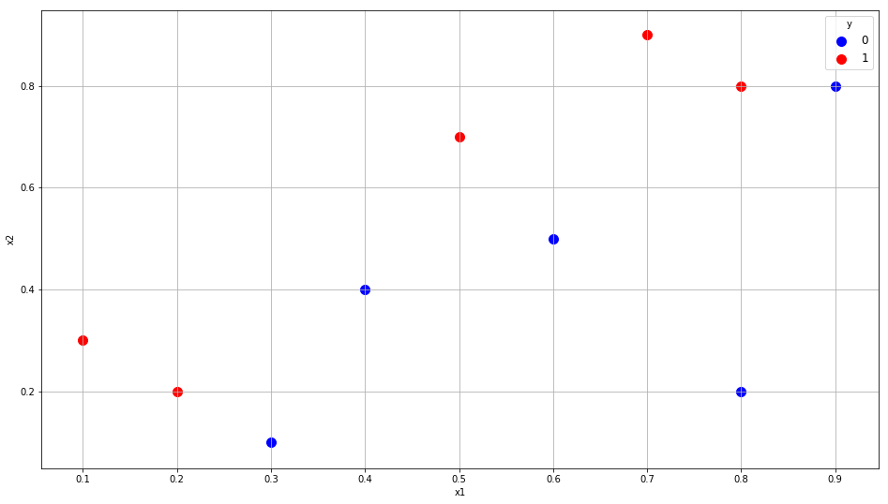
Boosting: Toy Example
Index | x1 | x2 | y
0 | 0.1 | 0.3 | 1
1 | 0.2 | 0.2 | 1
2 | 0.3 | 0.1 | 0
3 | 0.4 | 0.4 | 0
4 | 0.5 | 0.7 | 1
5 | 0.6 | 0.5 | 0
6 | 0.7 | 0.9 | 1
7 | 0.8 | 0.8 | 1
8 | 0.8 | 0.2 | 0
9 | 0.9 | 0.8 | 0

Slide 44
Boosting: A Strong Learner Toy Example
classTree = tree.DecisionTreeClassifier(criterion='entropy', max_depth=10, random_state=60616)
treeFit = classTree.fit(x_train, y_train)
treePredProb = classTree.predict_proba(x_train)
accuracy = classTree.score(x_train, y_train)
Accuracy is 1

Slide 45
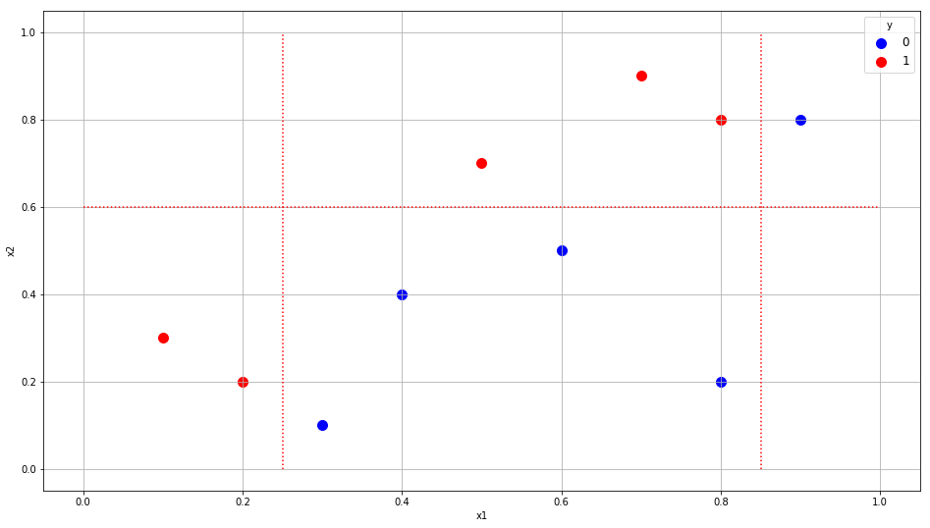
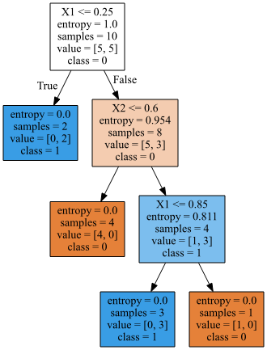
Boosting: A Strong Learner Toy Example

Slide 46
Boosting: A Weak Learner Toy Example
x_train = numpy.array([[0.1, 0.3],
[0.2, 0.2],
[0.3, 0.1],
[0.4, 0.4],
[0.5, 0.7],
[0.6, 0.5],
[0.7, 0.9],
[0.8, 0.8],
[0.8, 0.2],
[0.9, 0.8]], dtype = float)
y_train = numpy.array([1, 1, 0, 0, 1, 0, 1, 1, 0, 0], dtype = float)
w_train = numpy.array([1, 1, 1, 1, 1, 1, 1, 1, 1, 1], dtype = float)
classTree = tree.DecisionTreeClassifier(criterion='entropy', max_depth=1, random_state=60616)
treeFit = classTree.fit(x_train, y_train, w_train)
treePredProb = classTree.predict_proba(x_train)
AUC = metrics.roc_auc_score(y_train, treePredProb[:,1])
print('Area Under Curve = ', AUC)
Suppose the maximum number of depths is restricted to 1

Slide 47
Boosting: Iteration 1
Iteration 1:
eventError = numpy.empty((10, 1))
predClass = numpy.empty((10, 1))
for i in range(10):
if (y_train[i] == 0):
eventError[i] = 0 - treePredProb[i,1]
else:
eventError[i] = 1 - treePredProb[i,1]
if (treePredProb[i,1] >= treePredProb[i,0]):
predClass[i] = 1
else:
predClass[i] = 0
if (predClass[i] != y_train[i]):
w_train[i] = 1 + numpy.abs(eventError[i])
else:
w_train[i] = numpy.abs(eventError[i])
Grow one level deep tree
Weighted by Oweight (equals 1 at Iteration 1)
Score the training data
Misclassified observations are weighted by 1 + ABS(Error), otherwise weight by ABS(Error)

Slide 48
Boosting: Iteration 1
Accuracy = 0.7
CaseID | y | Old Weight | Pr(y=0) | Pr(y=1) | Error | Pred. Class | New Weight
1 | 1 | 1 | 0 | 1 | 0 | 1 | 0
2 | 1 | 1 | 0 | 1 | 0 | 1 | 0
3 | 0 | 1 | 0.625 | 0.375 | -0.375 | 0 | 0.375
4 | 0 | 1 | 0.625 | 0.375 | -0.375 | 0 | 0.375
5 | 1 | 1 | 0.625 | 0.375 | 0.625 | 0 | 1.625
6 | 0 | 1 | 0.625 | 0.375 | -0.375 | 0 | 0.375
7 | 1 | 1 | 0.625 | 0.375 | 0.625 | 0 | 1.625
8 | 1 | 1 | 0.625 | 0.375 | 0.625 | 0 | 1.625
9 | 0 | 1 | 0.625 | 0.375 | -0.375 | 0 | 0.375
10 | 0 | 1 | 0.625 | 0.375 | -0.375 | 0 | 0.375

Slide 49
Boosting: Iteration 2
Accuracy = 1 – (0.375/6.75) = 0.9444444
CaseID | y | Old Weight | Pr(y=0) | Pr(y=1) | Error | Pred. Class | New Weight
1 | 1 | 0 | 1 | 0 | 1 | 0 | 2
2 | 1 | 0 | 1 | 0 | 1 | 0 | 2
3 | 0 | 0.375 | 1 | 0 | 0 | 0 | 0
4 | 0 | 0.375 | 1 | 0 | 0 | 0 | 0
5 | 1 | 1.625 | 0.0714286 | 0.928571 | 0.0714286 | 1 | 0.07142857
6 | 0 | 0.375 | 1 | 0 | 0 | 0 | 0
7 | 1 | 1.625 | 0.0714286 | 0.928571 | 0.0714286 | 1 | 0.07142857
8 | 1 | 1.625 | 0.0714286 | 0.928571 | 0.0714286 | 1 | 0.07142857
9 | 0 | 0.375 | 1 | 0 | 0 | 0 | 0
10 | 0 | 0.375 | 0.0714286 | 0.928571 | -0.928571 | 1 | 1.92857143
Total |  | 6.75

Slide 50
Boosting: Iteration 3
Accuracy = 1 – (0 / 6.1428568) = 1
CaseID | y | Old Weight | Pr(y=0) | Pr(y=1) | Error | Pred. Class | OWeight
1 | 1 | 2 | 0 | 1 | 0 | 1 | 0
2 | 1 | 2 | 0 | 1 | 0 | 1 | 0
3 | 0 | 0 | 0 | 1 | -1 | 1 | 2
4 | 0 | 0 | 0 | 1 | -1 | 1 | 2
5 | 1 | 0.07142857 | 0 | 1 | 0 | 1 | 0
6 | 0 | 0 | 0 | 1 | -1 | 1 | 2
7 | 1 | 0.07142857 | 0 | 1 | 0 | 1 | 0
8 | 1 | 0.07142857 | 0 | 1 | 0 | 1 | 0
9 | 0 | 0 | 0 | 1 | -1 | 1 | 2
10 | 0 | 1.92857143 | 1 | 0 | 0 | 0 | 0

Slide 51
Boosting: Toy Example
Iteration | Ensemble Weight (Accuracy)
1 | 0.7
2 | 0.944444
3 | 1.0
Iteration stops since the Weighted Accuracy has reached 1
Ensemble Prediction:
Boost_P_Y1 = (0.7 * P_Y1_Iteration1 + 0.9444444 * P_Y1_Iteration2 + 1 * P_Y1_Iteration3) / (0.7 + 0.944444 + 1)
Boost_P_Y0 = 1 – Boost_P_Y1

Slide 52
Boosting: Toy Example
caseID | x1 | x2 | y | Boost_P_Y0 | Boost_P_Y1 | Boost_Pred_Y | Misclassify?
1 | 0.1 | 0.3 | 1 | 0.35713 | 0.64287 | 1 | False
2 | 0.2 | 0.2 | 1 | 0.35713 | 0.64287 | 1 | False
3 | 0.3 | 0.1 | 0 | 0.52258 | 0.47742 | 0 | False
4 | 0.4 | 0.4 | 0 | 0.52258 | 0.47742 | 0 | False
5 | 0.5 | 0.7 | 1 | 0.19095 | 0.80905 | 1 | False
6 | 0.6 | 0.5 | 0 | 0.52258 | 0.47742 | 0 | False
7 | 0.7 | 0.9 | 1 | 0.19095 | 0.80905 | 1 | False
8 | 0.8 | 0.8 | 1 | 0.19095 | 0.80905 | 1 | False
9 | 0.8 | 0.2 | 0 | 0.52258 | 0.47742 | 0 | False
10 | 0.9 | 0.8 | 0 | 0.56911 | 0.43089 | 0 | False

Slide 53
Adaptive Boosting in Python
You can, of course, implement your own Adaptive Boosting function
Python offers efficient ways to perform Adaptive Boosting
sklearn.ensemble.AdaBoostClassifier
sklearn.ensemble.AdaBoostRegressor

Slide 54
Ensemble Method
Closing Remarks:
Bagging or Boosting often improves model performance
The algorithm is not difficult to implement
However, we do not have one single model and thus cannot represent all the models altogether (e.g., in a single tree diagram or equation)
The execution time is longer, and special attention in avoiding a run-away iterative process

Slide 55
Other Ensemble Methods
Gradient Boosting Machine (GBM)
The principle idea behind the GBM algorithm is to construct the new base-learners to be maximally correlated with the negative gradient of the loss function associated with the whole ensemble.
Hastie, T. J., Tibshirani, R. J., and Friedman, J. H. (2001). The Elements of Statistical Learning: Data Mining, Inference, and Prediction. New York: Springer-Verlag.

Slide 56
Assignment 5
Assignment 5 has been posted
Due date is 11:59 pm on Tuesday, April 30, 2019
Maximum score is 200
Maximum two attempts, only the most recent attempt is graded
Must submit Python codes with the assignment. Otherwise, the teaching assistant may deduct 50% of your question score
Name your Python codes or Jupyter notebooks as Q1.py or Q1.ipynb

